Slide 1
Ozeri Touch Digital Bath Scale
Measures weight, body fact, hydration level, muscle mass, and bone index, using bioelectrical impedance analyzing algorithms.
Automatically powers on upon stepping on and powers off when no contact.
Up to 8 profiles and auto reconigtion.
High quality impact-resistant tempered glass as surface.
Runs on 2 included Lithium batteries.
Price is $42.95 on Amazon.

Slide 2
Omron BP785 10 Series Upper Arm Blood Pressure Monitor
Highest configuration among familiy members.
Dual sensors automatically double check each reading.
Indicator confirms the cuff has been wrapped correctly.
Automatically takes three consecutive readings one minute apart and displays the average.
Detect and alert irregular heartbeats while the blood pressure is being measured
200 memory storage with a date and time stamp.
Price: $69.99

Slide 3
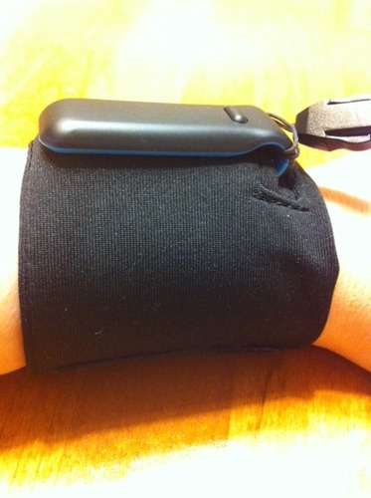
Fitbit Ultra Wireless Activity Plus Sleep Tracker
Fast charge and long lasting.
Accurately tracks daily steps, stairs climbed, distance, calories burned, and activity level via 3-d motion sensor and altimeter technology.
Measures how long and how well you sleep - just wear it on your wrist at night with Fitbit wristband (included).
Small and discreet enough to wear all day. Tell wakeup times, typical 90-minute cycle of sleep reflected.
Wirelessly uploads data to Fitbit.com within 15 feet of computer; No monthly fee. Data accessible any where with Internet, including an iPhone app.
Good for losing weight.
Price: $95.73

Slide 4
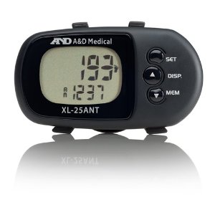
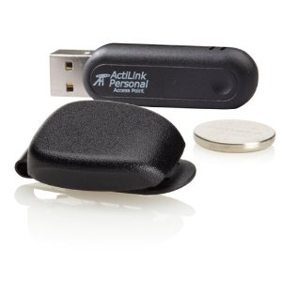
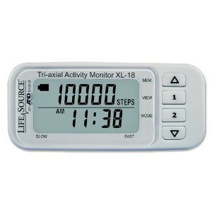
Lifesource Xl-25ant Ehealth Wireless Activity Monitor
$46.79
LifeSource XL-20 Wireless Activity Monitor
$32.98
Lifesource Xl-18 Tri-axial Activity Monitor
$18.99

Slide 5
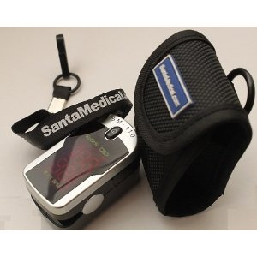
Finger Pulse Finger Pulse Oximeter SM-110 with Carry Case and Neck/Wrist Cord
SP02, PR are displayed on screen, simple and convenient operation
It is light, compact and weight is 50g including batteries.
Low power consumption, two AAA batteries can be continuously operated for 30 hours
It can be used by a variety of sports enthusiasts, including others interested in measuring oxygen saturation and pulse rate
Easy to carry : Neck/wrist cord, easy carrying soft case, 1 Year Warranty
Same result compared to hospital oximeter according to some buyer reviews.
$42.95

Slide 6
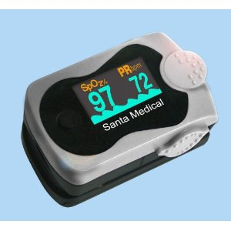
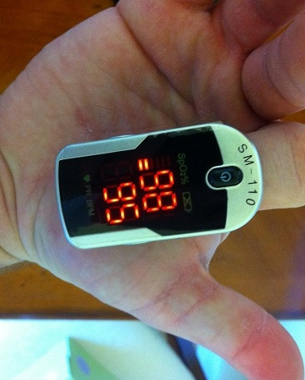
Oximeter SM-110
$42.95
Santamedical SM-240 OLED Finger Pulse Oximeter
$59.95

Slide 7
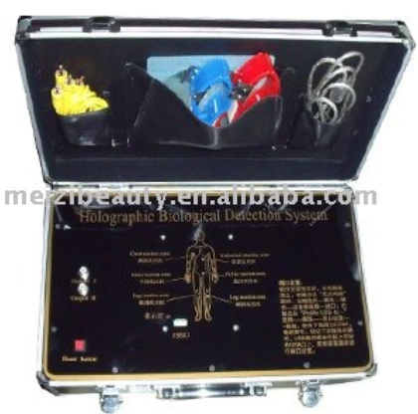
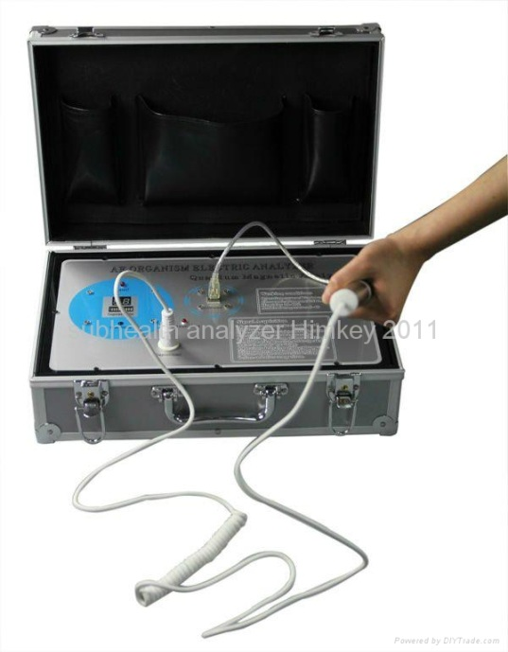
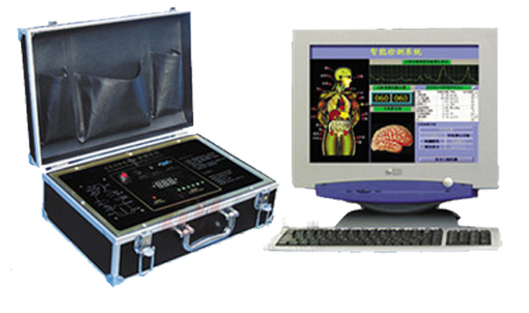
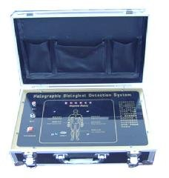
Quantum Resonance Magnetic (Body) Analyzer
Quantum Bioelectrical Analyzer
Quantum Body/Health Analyzer/Monitor
Holographic Bioelectrical Analyzer

Slide 8
Mini Quantum Magnetic Resonance Body Analyzer
Operating system: Windows 98 SE, ME, 2000, XP, VISTA and Windows 7 32 bit
MINI SIZE C:17.5*11*5CM
English or Spanish (you can select language just by sending a message)
English or Spanish as you select (default is english but if you need in spanish just send a message) Simple and convenient: It is easy in operation and in general, people will be able to analyze and interpret the result through short-term training. Health check can be performed in any place and at any time, saving the time of patients. The cost for analysis is adequate and can be accepted by most consumers. This instrument is an ideal promotion tool for beauty salon, SPA club, clinics, health examination centre, health food/nutrition suppliment/health care products shop, direct selling, massage center, etc. The operator can write out prescription based on testing reports. It's also suitable for family use. FREE SPECIALICED TRAINING AND FREE UPDATES AFTER 100% CUSTOMER SATISFACTION
$300.00

Slide 9
1.cardiovascular and cerebrovascular
2.gastrointestinal function
3.liver function
4.gallbladder function
5.pancreatic function
6.kidney function
7.lung function
8.brain nerve
9.bone disease
10.bone mineral density
11.rheumatoid bone disease
12.blood sugar
13.basic physical quality
14.human toxin
15.trace slement
16.endocrine systerm
17.immune systerm
18.gynecology
19.Skin
20 breast
21.element of human
22.amino acid
23.heavy metals
24.male sexual function
25.prostate
26.allergen

Slide 10
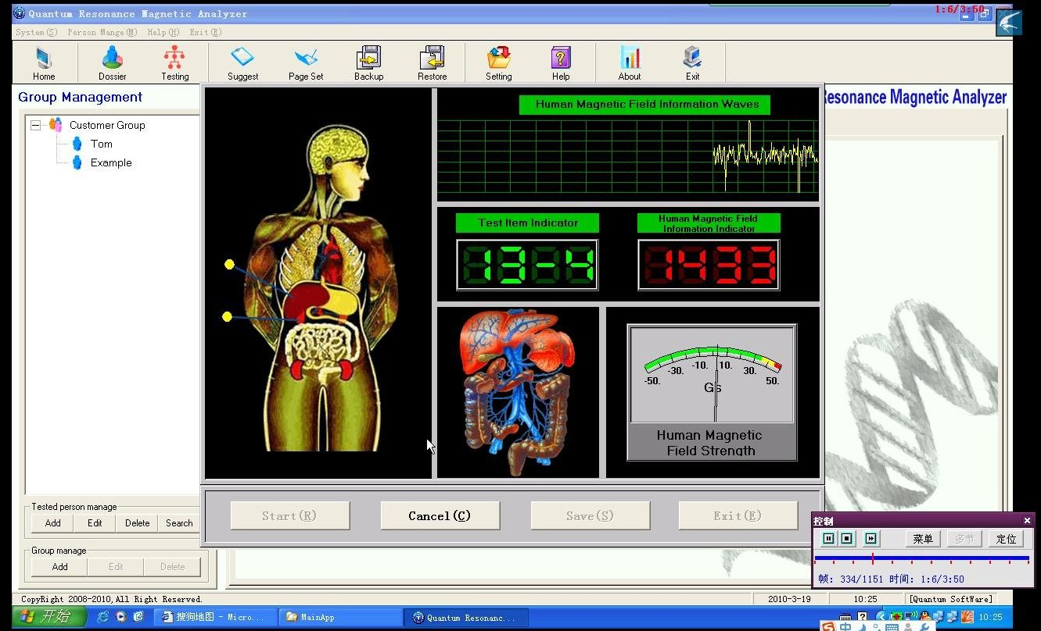

Slide 11
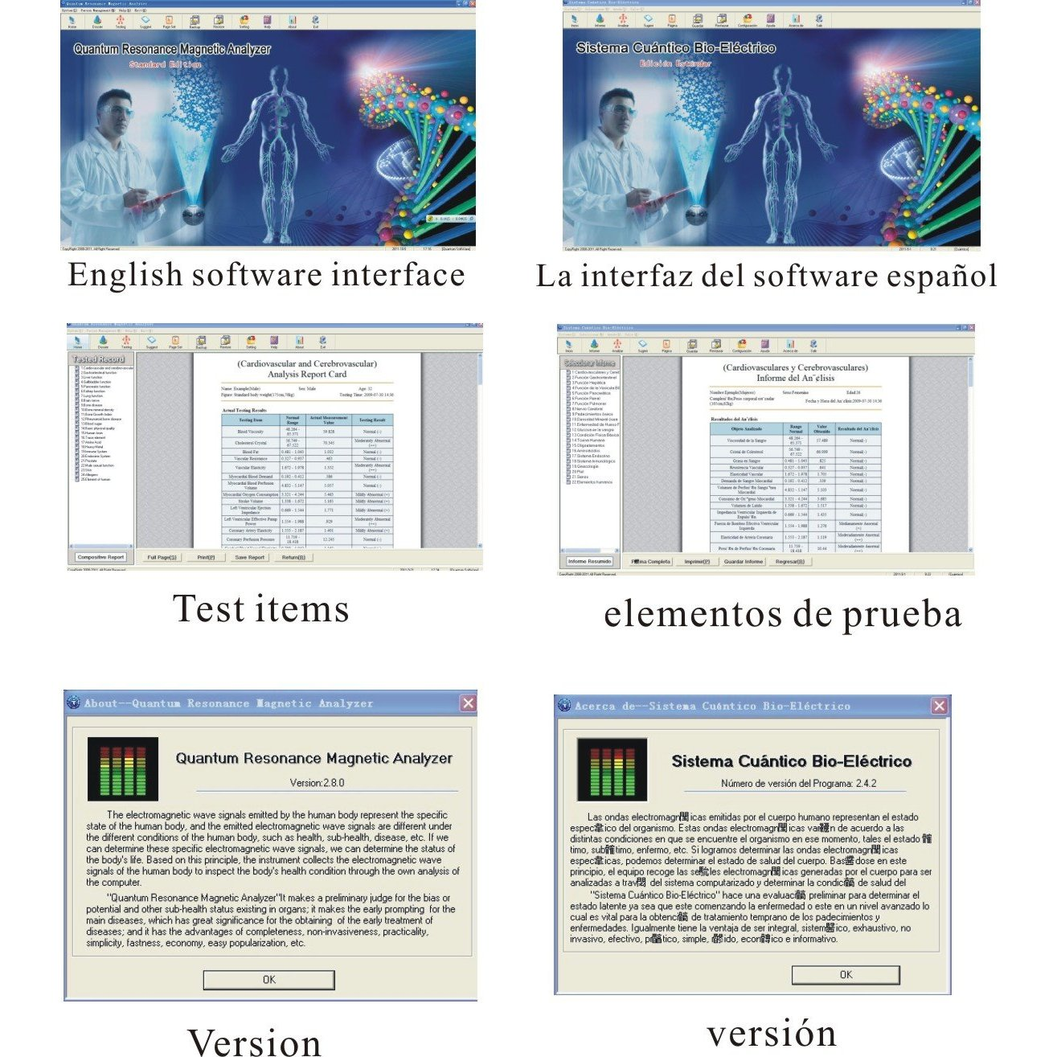

Slide 12
END

