Slide 1
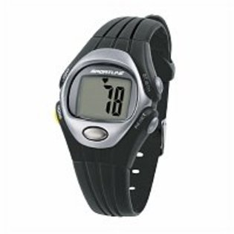
Solo 900 (Sportline)
List of key features
Monitors heart rate without band strap
Button must be pushed for heart rate to be measured
Also includes a pedometer
Can be Purchased at Sears
Cost: $59.99

Slide 2
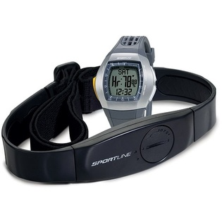
Duo 1025
List of key features
Monitors heart rate with and without band strap
Button must be pushed for heart rate to be measured without belt
With belt heart is continuously measured
Includes Calorie monitor
Can be Purchased at Sears
Cost: $71.99

Slide 3
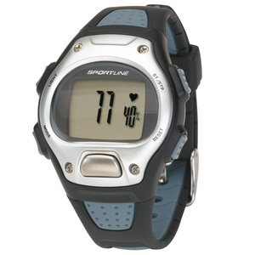
S7 Sportline
List of key features
Monitors heart rate without band strap
Button must be pushed for heart rate to be measured
Stop watch
Calorie Burn Monitor
Can be Purchased at Wal-Mart
Cost: $28.97

Slide 4
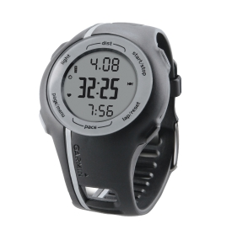
Garmin Forerunner 110
List of key features
Monitors heart rate with and without band strap
Continuous heart monitoring or discrete heart monitoring
GPS Enabled
Rechargeable battery
Records history of use
Can be Purchased at Dicks Sporting Goods
Cost: $199.99

Slide 5
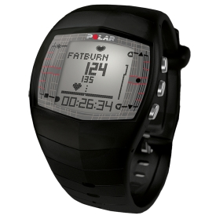
Polar
List of key features
Measures heart rate in beats per minute and % of max
Average and maximum heart rate during training
Logs information from watch onto website for user to monitor progress
Measures calories
Measures aerobic fitness of customer
Can be Purchased at Dicks Sporting Good
Cost: $159.99

Slide 6
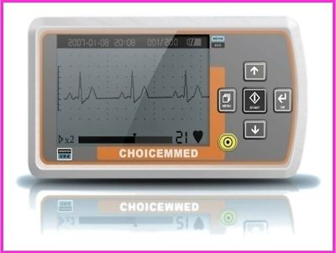
Portable Handheld ECG EKG Heart Monitor-MD100A1 U.S.A
List of key features
Measures within 30 seconds
Records of ECG Strips for 200 strips, each record with 30-second ECG
Display of ECG waveform, heart rate, analysis results and battery status on the backlight LCD
Auto-evaluation based on detected heart data
Measurement results transmission to PC by USB mode
Conserves Power
Can be Purchased on Ebay.com
Cost: $159.00

Slide 7
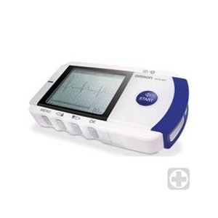
Omron Portable Ecg Monitor - Omron HCG-801
List of key features
Displays messages concerning Heart rate and rhythm
SD Memory slot for PC downloads
Includes Software C
cordless and compact for use anywhere
Analyzes ECG data
Records CVD symptoms for up to 30 seconds
Can be Purchased on Amazon.com
Cost: $303.64

Slide 8
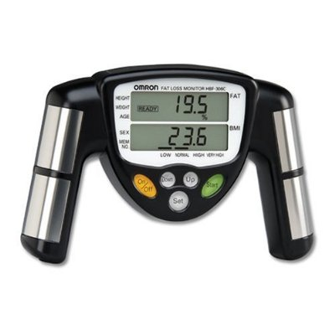
Omron HBF-306C Fat Loss Monitor
List of key features
Measures body fat and Body mass index
Holds memory and measures overall progress of user such as weight loss
Can be Purchased on Amazon.com
Cost: $68.99

Slide 9
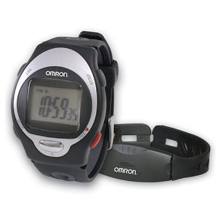
Omron HR-100C Heart Rate Monitor
List of key features
heart rate monitor is easy to program
Comfortable to wear with ventilated watch band
Helps maintain a proper heart rate with a high/low heart rate alarm
Chest transmitter belt sends data to the receiver at a distance of up to 98 feet (30 meters)
Can be Purchased on Amazon.com
Cost: $34.99

Slide 10
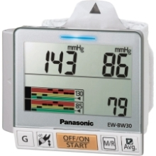
Panasonic - EW-BW30S Blood Pressure Monitor
List of key features
Pulse/Heart Rate: 30 to 160 pulse/min ± 5 %
Features: Alarm, Calendar, Recording Function, Time Function
Pressure: 0 mmHg to 280 mmHg ± 3 mmHg
2 Year Warranty
Can be Purchased at Best Buy.com
Cost: $58.59

Slide 11
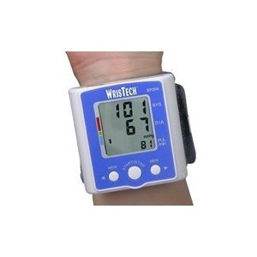
N American Healthcare Wristech Blood Pressure Monitor
List of key features
Fully Automatic, Clinical Accuracy
60 Memory Capacity
One Size Adjustable Cuff Fits All
Can be Purchased at Amazon.com
Cost: $14.95

Slide 12
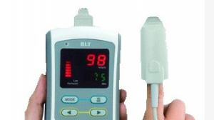
Biolight Handheld Pulse Oximeter M700
List of key features
Parameter: digital SPO2, Pulse Rate, Pulse Bar.
4 AA batteries
Anti-Movement Stable Performance
Accurate Measurement during rest
Easy to Read LED screen
Can be Purchased on VentureMedical.com
Cost: $249.00

Slide 13
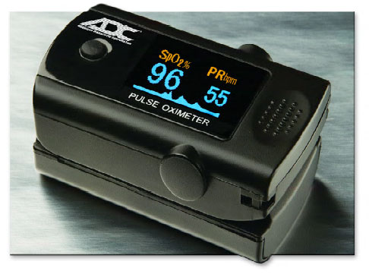
ADC Digital Fingertip Pulse Oximeter - Diagnostix 2100
List of key features
a simple non-invasive digital device that indirectly measures the oxygen saturation of a patient's blood (SPO2).
digitally displays the percentage of SPO2 along with the patient’s pulse rate in 6 changeable display modes.
Can be Purchased on VentureMedical.com
Cost: $97.00

Slide 14
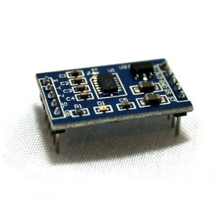
Virtuabotix MMA7361 Three Axis Accelerometer Module
List of key features
rapid response time, and high tolerance for noise
Two sensitivity modes ±1.5G and ±6G | supports both 5 & 3.3 Volt operation
Product comes with Pin-Out, and getting started guide
2X5 pin headers (5 pin minimum) | 0G-detect pin (for Free Fall detection)
Can be Purchased on Amazon.com
Cost: $17.95

Slide 15
PCB Piezotronics 352C23 Accelerometer Vibration Sensor Miniature Lightweight
List of key features
Miniature, lightweight (0.2 gm), ceramic shear ICP® accel., 5 mV/g, 2 to 10k Hz
10-ft detachable cable
Measurement Range: ±1000 g pk (±9810 m/s² pk)Broadband Resolution: (1 to 10000 Hz) 0.003 g rms (0.03 m/s² rms)
Frequency Range: (±5%) 2.0 to 10000 HzMounting:
AdhesiveWeight: 0.007 oz (0.2 gm)
Can be Purchased on Ebay.com
Cost: $45.00

Slide 16
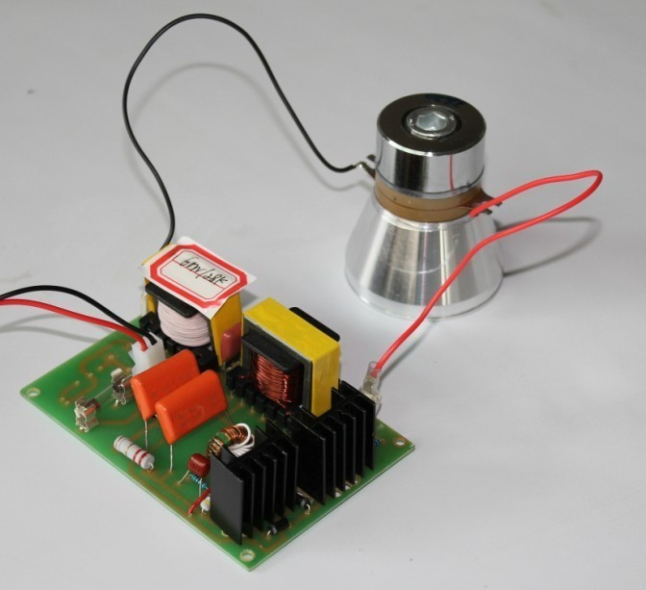
60W ULTRASOUND GENERATOR & 28KHz Ultrasonic transduce
List of key features
High Mechanical Quality and excellent electro-acoustic conversion efficiency,providing a high ouput amplitude.
Piezoelectric element offer a high speed of vibration. Through bolt-on mounting, mechanical intensity and amplitude have been improved.
Having steady output amplitude even the load markedly changed.
Extended using temperature, ensuring good amplitude linearity.
Lower resonant impedance, ensuring high conversion efficiency.
Can be Purchased on Ebay.com
Cost: $99.99

Slide 17
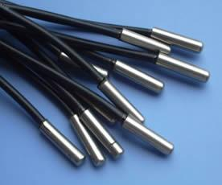
PT100 Thermal Probe Temperature Sensor
List of key features
Temperature rang :-50-250 C
Cable Length: about 100cm
External Shielding: Insulated Shielding
Internal Insulation:Fiberglass
Can be Purchased on Ebay.com
Cost: $5.18

Slide 18
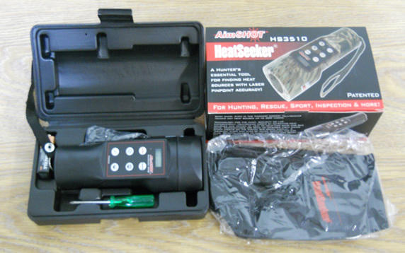
Thermal Heat Sensor HS3510B
List of key features
64 different intensity settings
tracks accurately up to 300 yards
Detects objects as close as 2
Wavelength emitted 650nm
Can be Purchased on Ebay.com
Cost: $106.99

